Slide 1
Community Board 9
Thierno Bah
thiernoamadoubah@gmail.com

Slide 2
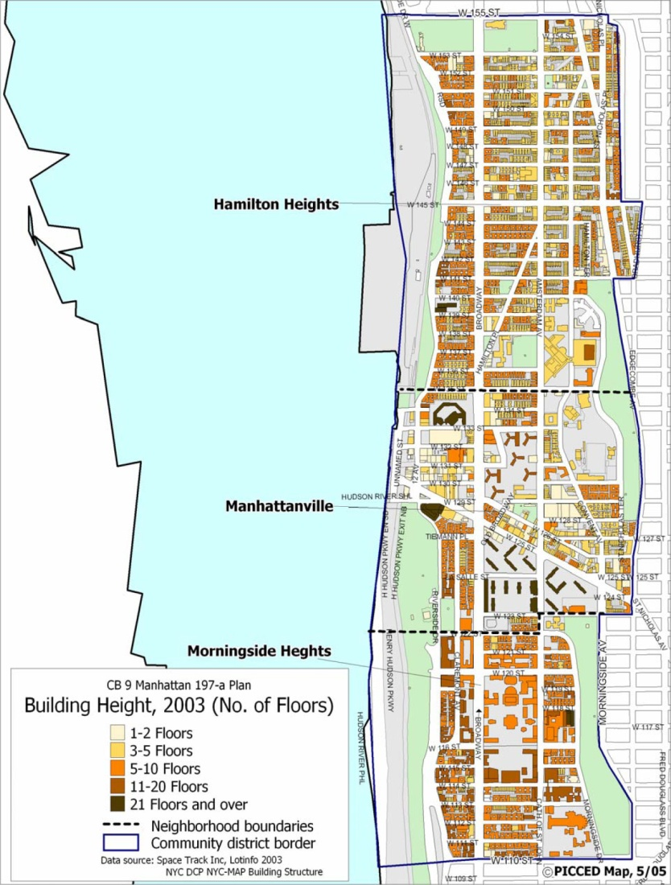
Map of community Board 9

Slide 3
Intro to Community board 9
Manhattan Community District 9 encompasses the West Harlem neighborhoods of Morningside Heights, Manhattanville, and Hamilton Heights.
District Manager: Eutha Prince
Chair: Hon. Padmore John.

Slide 4
Community District Digital Footprint
Website:
The link of community board 9 website is:
http://www.nyc.gov/html/mancb9/html/home/home.shtml.
The address, contact, and office hours of community board 9 is found in the main page of the website.
Community members, staffs, and committees are all
listed in the website.
The website also displays the news and calendar events
Of the community board.

Slide 5
Social Media
Facebook:
The community board 9 is active on facebook .
It posts about educational and employment opportunities.
It also share sport and artistic events taking place in the community board.
Twitter:
The account is inactive since 2012.

Slide 6
Seasonal Data Analysis
Assumptions
Winter: Heat Complaints
Spring: Flood Complaints
Summer: Noise Complaints
Fall: Trash Complaints
Reality
Winter: Heat Complaints
Spring: Heat Complaints
Summer: Noise Complaints
Fall: Heat Complaints

Slide 7
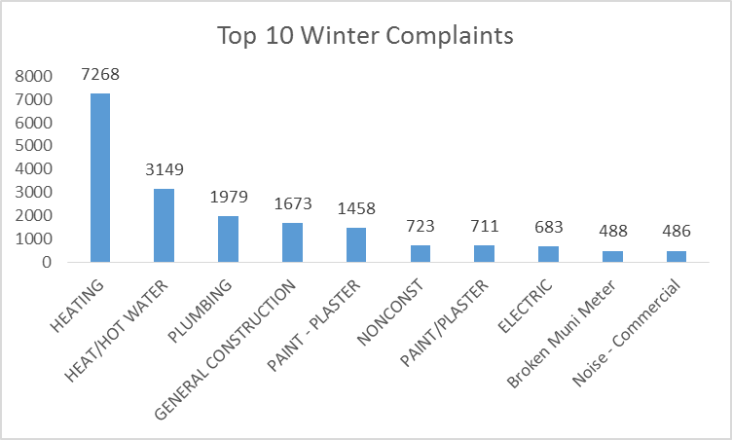
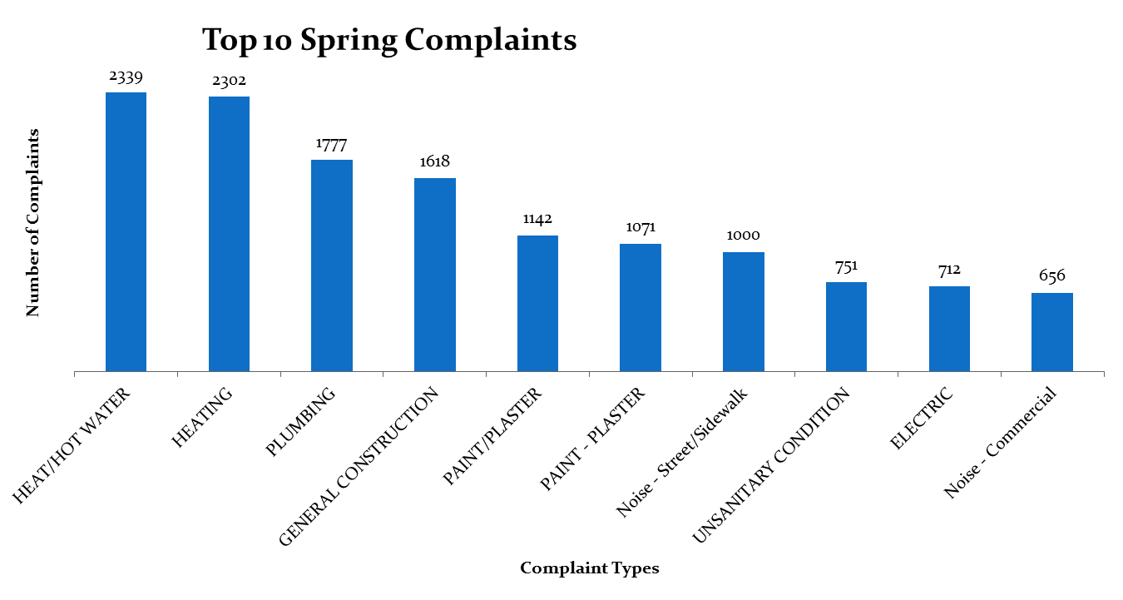
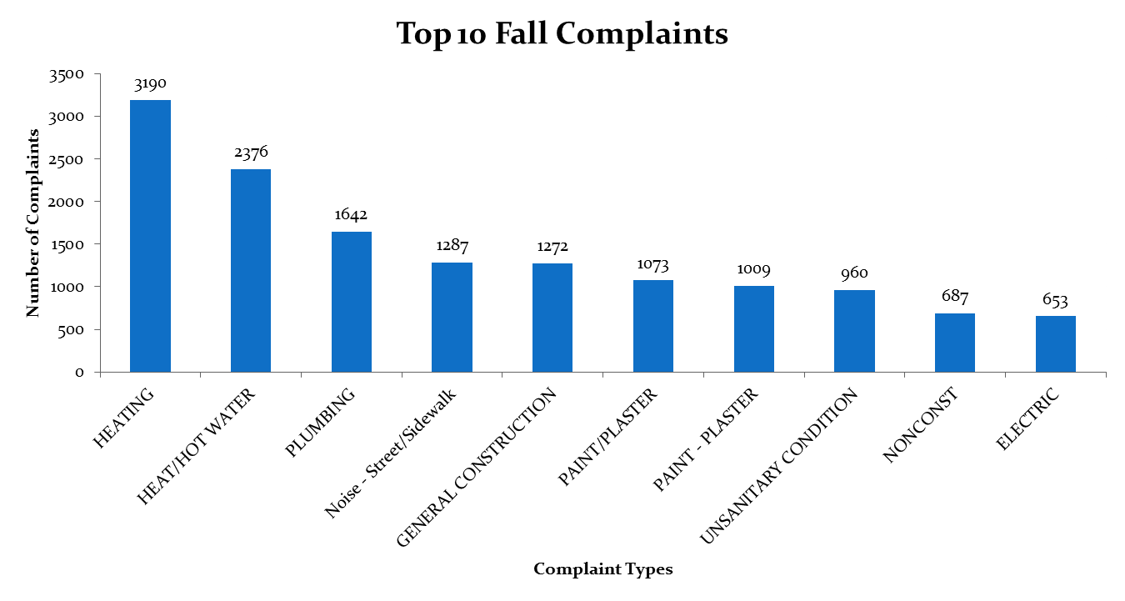
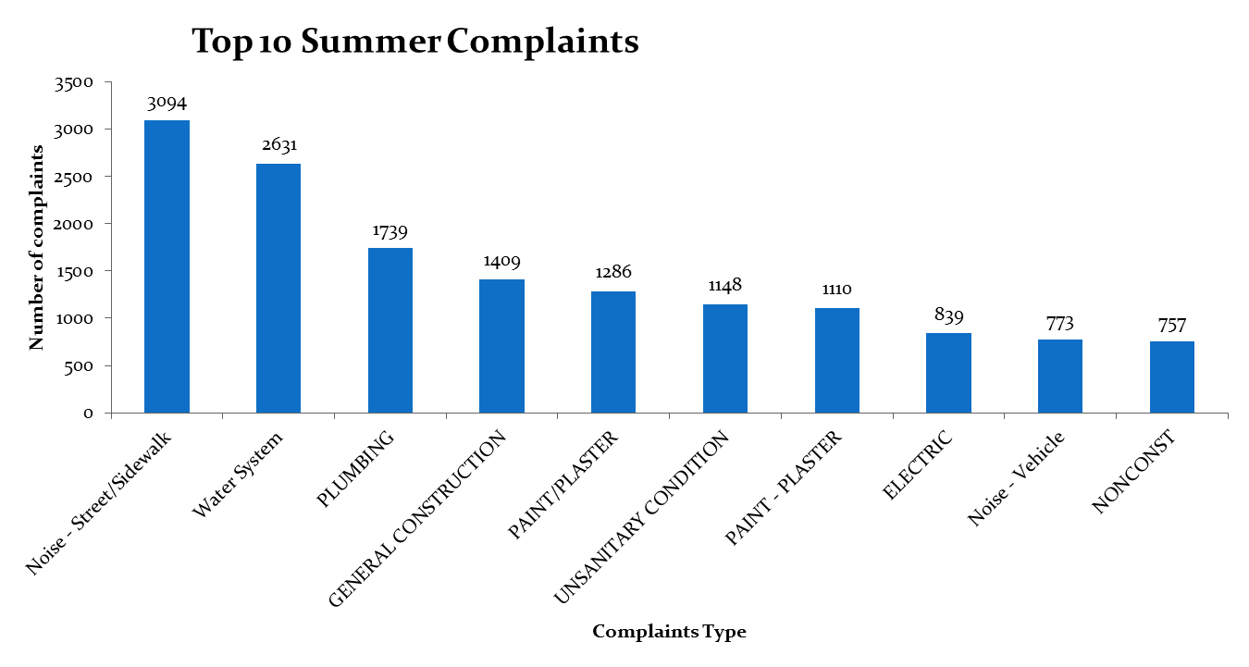
Seasonal Data Analysis

Slide 8
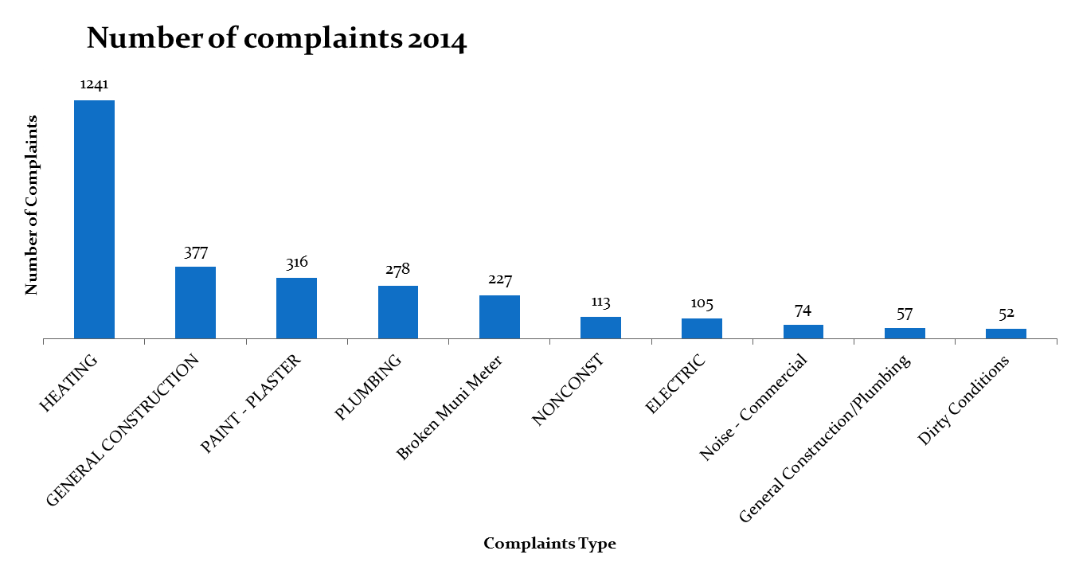
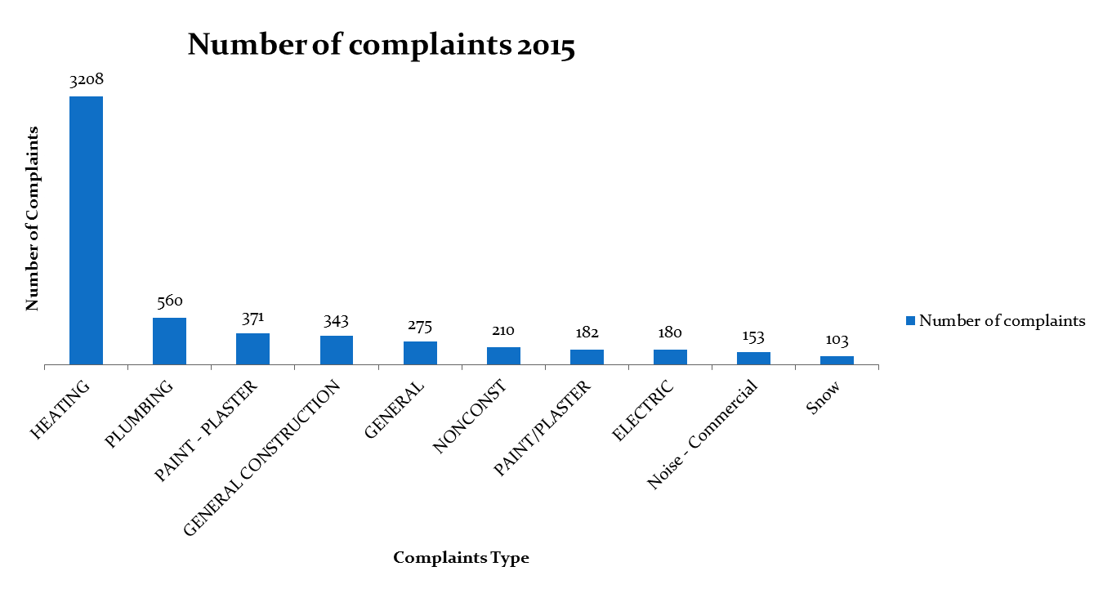
Comparison Between winter 2014 vs. winter 2015

Slide 9
Comparison Between winter 2014 vs. winter 2015
Remarks:
In 2015, there is a twofold increase in the number of complaints regarding heating, plumbing, and noise compared to the previous year.
If this trend continues, we’ll observe a higher increase in these categories in winter 2016.

Slide 10
Heat/Hot Water Service Requests
Months with the most heat/hot water service requests:
According the 311 open data, the months of November to March register the most heat/hot water service requests throughout the year.
The data makes sense as these months are among the coldest in the year.

Slide 11
Heat/Hot Water Service Requests

Slide 12
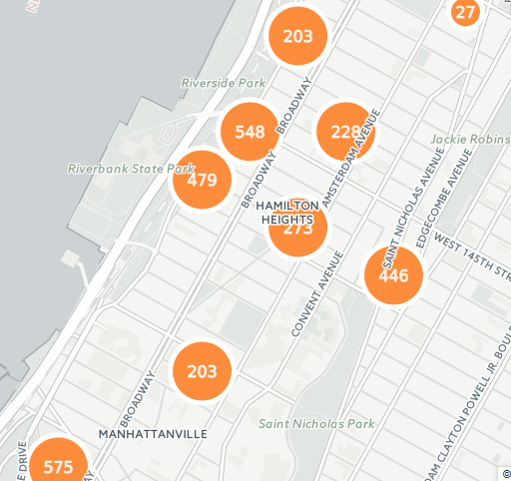
Heat/Hot Water Service Requests
720 Riverside Dr.
684 Riverside Dr.
519 West 147 Street
644 Riverside Dr.
1661 Amsterdam Ave.
180 Edgecombe Ave.
509 West 135 Street
41 Tiemann Ave.

Slide 13
Heat/Hot Water Service Requests

Slide 14
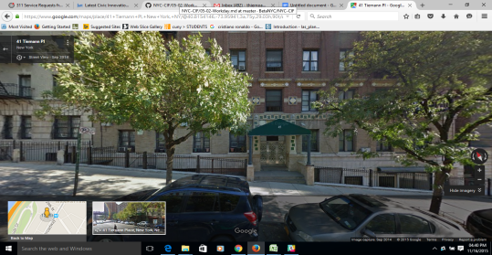
Heat/Hot Water Service Requests
41 Tiemann Avenue, 575 calls.
Picture:
Picture:

Slide 15
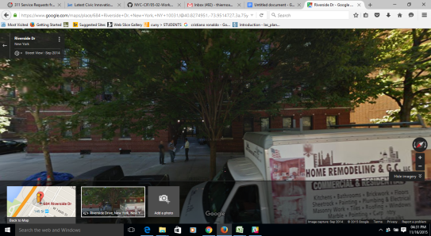
Heat/Hot Water Service Requests
684 Riverside Drive, 548 Calls.
Picture:

Slide 16
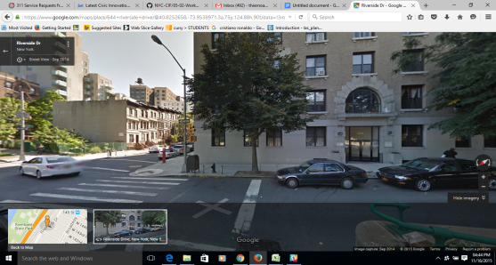
Heat/Hot Water Service Requests
644 Riverside Drive, 479 calls,
Picture:

Slide 17
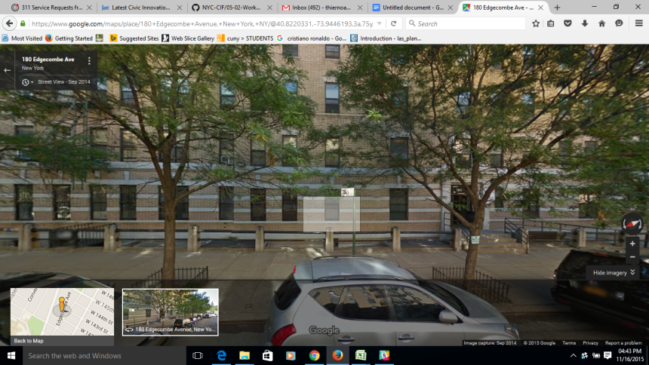
Heat/Hot Water Service Requests
180 Edgecombe Avenue, 446 calls.
Picture:

Slide 18
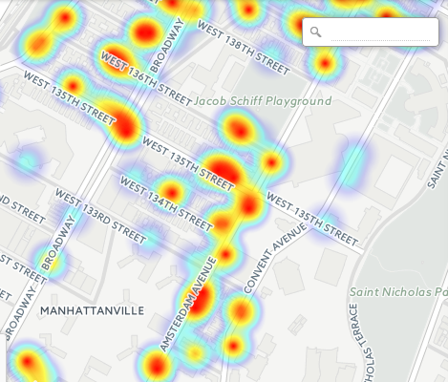
Rodent Service Request

Slide 19
Rodent Service Request
The intersection of Amsterdam Ave./Broadway and Broadway/ Riverside drive are the locations that have the most rodent complaints.
When we look at the pictures above, we see that both areas have subway stations and fast food restaurants around them. This might some of the reasons of the recurrence of complaints.

Slide 20
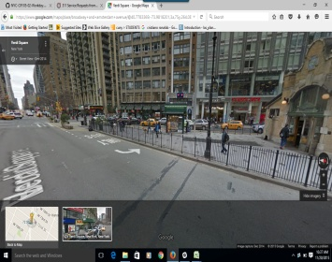
Rodent Complaints Hotspots
Amsterdam Ave./Broadway, 377 complaints.
Picture:

Slide 21
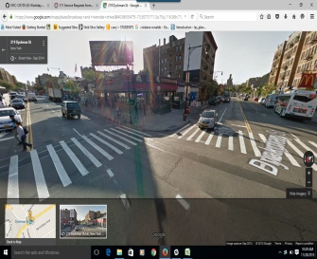
Rodent Complaints Hotspots
Broadway/Riverside Drive, 194complaints.
Picture:

Slide 22
Rodent Service Request

Slide 23
Street condition / pothole
Remarks:
When we analyze the table, we observe that the complaints regarding the cave-in condition go dramatically up during the summer season.

Slide 24
Street condition / pothole
Notes:
top five street condition issues per year:
Cave-In;
Hummock;
Failed Street Repair;
Pothole;
Rough, pitted, or cracked Roads;

Slide 25
Street condition / pothole

Slide 26
Street condition / pothole

Slide 27
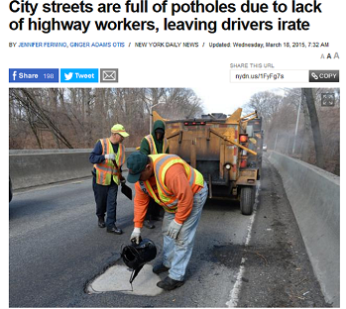

Street condition / pothole

Slide 28
Noise Complaints
Top 10 Noise Complaint Types:
Noise: Construction Before/After Hours (NM1)
Noise, Barking Dog (NR5)
Noise: Construction Equipment (NC1)
Noise: air condition/ventilation equipment (NV1)
Noise: Jack Hammering (NC2)
Noise: Alarms (NR3)
Noise, Ice Cream Truck (NR4)
Noise: Private Carting
Noise (NQ1) Noise: lawn care equipment (NCL)
Noise: Manufacturing Noise (NK1)

Slide 29
Noise Complaints

Slide 30
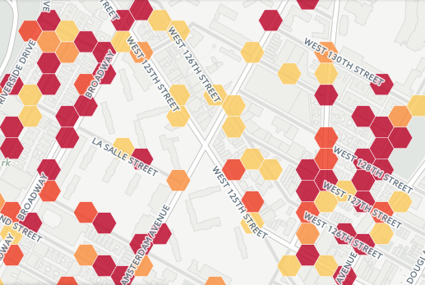
Noise Complaints
Broadway
St. Nicholas Terrace

Slide 31
Noise Complaints
Remarks:
In analyzing the data, we don't observe any seasonal pattern throughout the years in relation to noise service requests.

Slide 32
Illegal parking / blocked driveway Complaints
Remarks:
In observing the data in this table, we don't see complaints pattern by the months as there is no regularity across the years.
The only thing we can notice is that from 2014 upward there is a sharp increase in the number of complaints compared to the previous years.

Slide 33
Illegal parking / blocked driveway

Slide 34
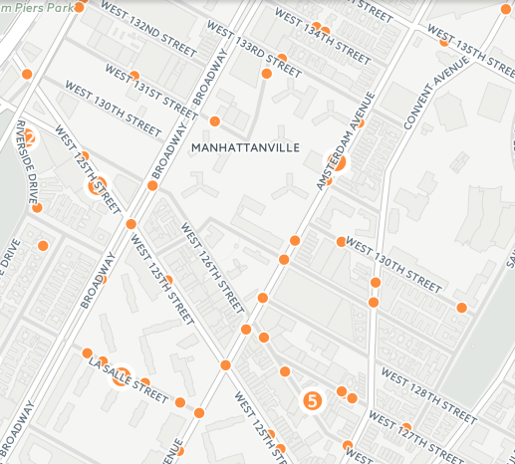
Illegal parking / blocked driveway

